Slide 1

PSYC401: Analysing and Interpreting Psychological Data I
Padraic Monaghan
Room C5, Fylde College
p.monaghan@lancaster.ac.uk

Slide 2
Module outline
Week 1: Introducing data, introducing Rstudio
Week 2: Manipulating data, using Rstudio
Week 3: Exploring data and creating figures and graphs, using Rstudio
Week 4: Categorical data and the chi-squared test – testing random versus structured?
Week 5: t-tests – testing whether two groups are different
Week 6: Research report/analysis
Week 7: Measurement, hypotheses, associations (correlations)
Week 8: Predicting behaviour: the linear model
Week 9: Data visualisation
Week 10: Predicting behaviour: developing the linear model

Slide 3
Objectives for Week 4
By the end of this session, you should be able to:
Understand the value of conducting statistical tests and interpreting p-values
Understand null effects and null hypotheses
Understand the difference between parametric and non-parametric data
Understand when to apply the Chi-squared test
Understand the relation between Cramer’s V test and the Chi-squared test
Be able to apply the Chi-squared test to data and interpret the result
Be able to apply Cramer’s V test to data

Slide 4

Example: Titanic
The ship Titanic sank in 1912 with the loss of most of its passengers
809 of the 1,309 passengers and crew died
= 61.8%
Research question: Did class (of travel) affect survival?
Notes:
Ask the audience what the null and hypothesis might be, what type of data we would have and what test we should consider using.

Slide 5
Chi squared Test
Null: There is NO association between class and survival
Research: There IS an association between class and survival
Class | Died | Survived | Total
1st | 123 | 200 | 323
2nd | 158 | 119 | 277
3rd | 528 | 181 | 709
Total | 809 | 500 | 1309
Notes:
Since we have two categorical variables and want to know if they are associated we can use a chi-squared test. Class could be considered as an ordinal variable but there are only 3 levels here and so a chi-squared test therefore be quite appropriate. Point out there are 3 rows and 2 columns in our table and hence this is called a 3x2 contingency table. Discuss whether the table suggests class and survival are connected and try to tease out that we might be better looking at the % of 1st class passengers that died/survived and compare this with the % for 2nd class and 3rd class.

Slide 6
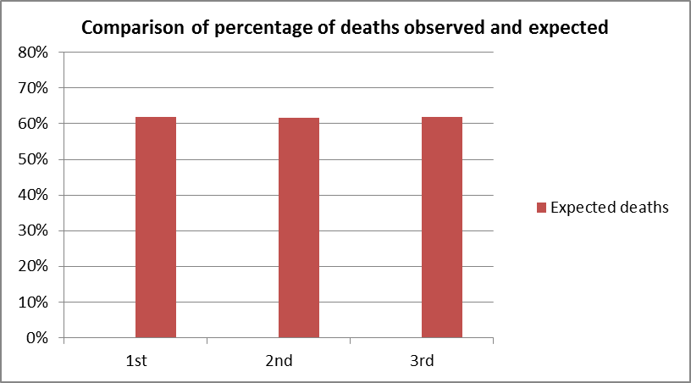
What would be expected if there is no association? Expected values
Same proportion of people would have died in each class!
Overall, 809 people died out of 1309 = 61.8%
Notes:
Discuss that this is what the % would be if there was no difference between the classes with respect to the chances of survival.

Slide 7
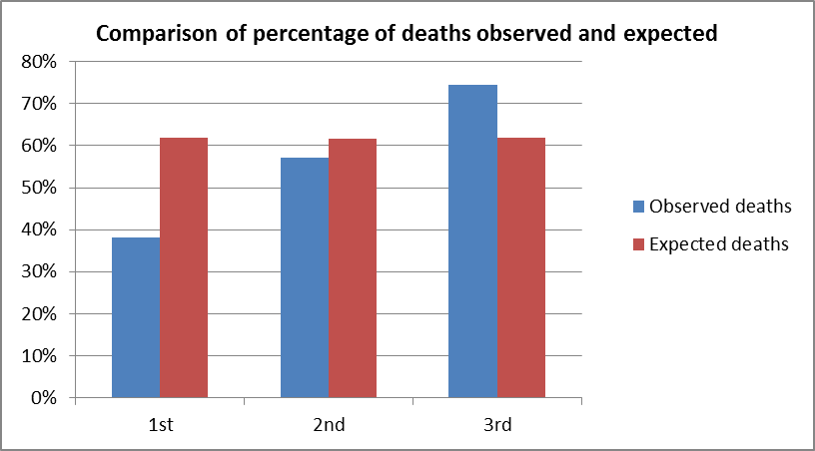
What would be expected if there is no association? Expected and actual values
Same proportion of people would have died in each class!
Overall, 809 people died out of 1309 = 61.8%
Notes:
Discuss that this is what the % would be if there was no difference between the classes with respect to the chances of survival.

Slide 8
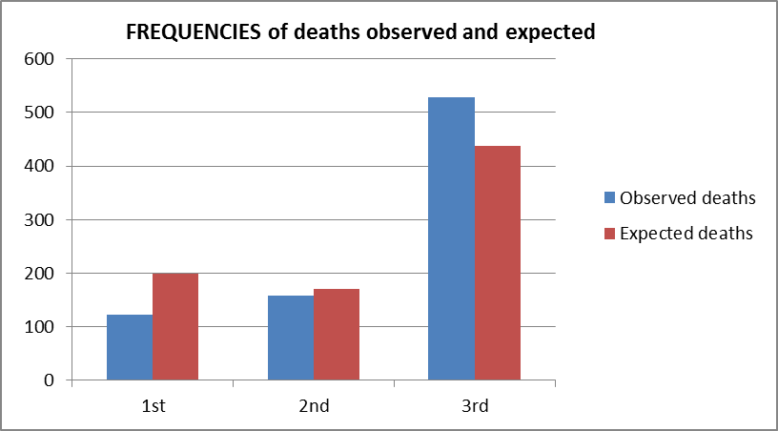
Chi-Squared Test Compares Observed and Expected Frequencies
Expected number dying in each class = 0.62 x number in each class
Notes:
This slide is shown since the chi-squared test formally compares the observed FREQUENCIES with the expected frequencies.

Slide 9
Chi-squared test statistic
The Chi-squared test is used when we want to see if two categorical variables are related
The test statistic for the Chi-squared test uses the sum of the squared differences between each pair of observed (O) and expected values (E)
Notes:
This is an optional slide if your session allowed time for this to be included and shows how the chi-squared test statistic compares the observed and expected.

Slide 10
Chi-squared test statistic: Computation
Class | Died | Survived | Total
1st | 123 | 200 | 323
2nd | 158 | 119 | 277
3rd | 528 | 181 | 709
Total | 809 | 500 | 1309
Observed
Expected
Class | Died | Survived | Total
1st | =323*.618 | =323*.382 | 323
2nd | =277*.618 | =277*.382 | 277
3rd | =709*.618 | =709*.382 | 709
Total | 809 | 500 | 1309
Notes:
This is an optional slide if your session allowed time for this to be included and shows how the chi-squared test statistic compares the observed and expected.

Slide 11
Chi-squared test statistic: Computation
Class | Died | Survived | Total
1st | 123 | 200 | 323
2nd | 158 | 119 | 277
3rd | 528 | 181 | 709
Total | 809 | 500 | 1309
Observed
Expected
Class | Died | Survived | Total
1st | =323*.618 | =323*.382 | 323
2nd | =277*.618 | =277*.382 | 277
3rd | =709*.618 | =709*.382 | 709
Total | 809 | 500 | 1309
Class | Died | Survived | Total
1st | 200 | 123 | 323
2nd | 171 | 106 | 277
3rd | 438 | 271 | 709
Total | 809 | 500 | 1309
Notes:
This is an optional slide if your session allowed time for this to be included and shows how the chi-squared test statistic compares the observed and expected.

Slide 12
Chi-squared test statistic: Computation
Class | Died | Survived | Total
1st | 123 | 200 | 323
2nd | 158 | 119 | 277
3rd | 528 | 181 | 709
Total | 809 | 500 | 1309
Observed
Expected
Class | Died | Survived | Total
1st | 200 | 123 | 323
2nd | 171 | 106 | 277
3rd | 438 | 271 | 709
Total | 809 | 500 | 1309
Notes:
This is an optional slide if your session allowed time for this to be included and shows how the chi-squared test statistic compares the observed and expected.

Slide 13
Chi-squared test statistic: Computation stage 2
Class | Died | Survived | Total
1st | 123-200 | 200-123 | 323
2nd | 158-171 | 119-106 | 277
3rd | 528-438 | 181-271 | 709
Total | 809 | 500 | 1309
O - E
(O - E)²
(O-E)²/E
Chi² = 127.86
Class | Died | Survived | Total
1st | -77 | 77 | 323
2nd | -13 | 13 | 277
3rd | 90 | -90 | 709
Total | 809 | 500 | 1309
Class | Died | Survived | Total
1st | 5869.7 | 5869.7 | 323
2nd | 173.9 | 173.9 | 277
3rd | 8070.9 | 8070.9 | 709
Total | 809 | 500 | 1309
Class | Died | Survived | Total
1st | 29.4 | 47.6 | 323
2nd | 1.0 | 1.6 | 277
3rd | 18.4 | 29.8 | 709
Total | 809 | 500 | 1309
Notes:
This is an optional slide if your session allowed time for this to be included and shows how the chi-squared test statistic compares the observed and expected.

Slide 14
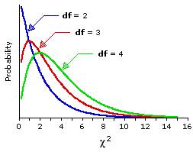
Chi squared distribution
The p-value is calculated using the Chi-squared distribution for this test
Chi-squared is a skewed distribution which varies depending on the degrees of freedom
degrees of freedom = (no. of rows – 1) x (no. of columns – 1)
For Titanic example, number of rows = 3 (class), number of columns = 2 (survived or not)
So for Titanic, degrees of freedom = …
Notes:
This slide is there to illustrate what the Chi-squared distribution looks like and that as the degrees of freedom increases (i.e. the amount of independent pieces of information we have from a study) then the more the wider the distribution is spread and becomes flatter.
Degrees of freedom = 2 for titanic

Slide 15
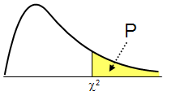
What’s a p-value?
In the Titanic example, the probability of getting a test statistic of 127.86 or above (just by chance) is < 0.001
P-value p < 0.001
Distribution of test statistics
Our test Statistic = 127.86
Notes:
This is to discuss what the p-value actually is.

Slide 16
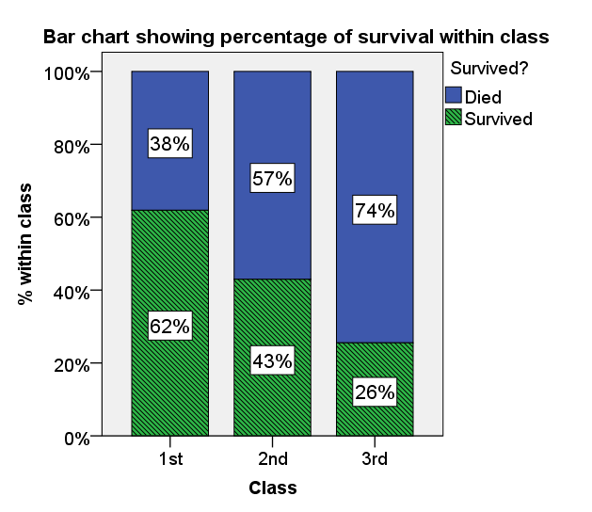
Interpretation of the Chi-squared test
Data collected on 1309 passengers aboard the Titanic was used to investigate whether class had an effect on chances of survival. There was evidence (χ²(2, N = 1309) = 127.86, p < 0.001) to suggest that there is an association between class and survival.
Figure 1 shows that class and chances of survival were related. As class decreases, the percentage of those surviving also decreases from 62% in 1st Class to 26% in 3rd Class.
Figure 1. Bar chart showing % of passengers surviving within each class
Notes:
For contingency table data, a multiple or stacked bar chart can be used based on frequencies or percentage within. Adding labels with the % to charts can be helpful.
When summarising data, encourage students not to include every table and graph and do not comment on every frequency or percentage. Think back to their original question of interest and answer that question and talk about every table/ graph you include in your report.

Slide 17
Assumptions of the Chi-squared test
Cells should have expected values >= 5
If any expected cell counts are <1 then cannot use the chi-squared distribution
In these cases, use Fishers’ Exact test
Notes:
Discuss what to do if there are low expected cell counts.

Slide 18
That’s the p-value. What about the effect?
How big is the relation between class and survival on the Titanic?
Chi-squared doesn’t tell us about the size of the association between categories because Chi-squared gets bigger the larger the numbers get:
Titanic: Chi²(2, N = 1309) = 127.86 Teenitinic: Chi² (2, N = 654) = 64.92
Class | Died | Survived | Total
1st | 123 | 200 | 323
2nd | 158 | 119 | 277
3rd | 528 | 181 | 709
Total | 809 | 500 | 1309
Class | Died | Survived | Total
1st | 61 | 100 | 161
2nd | 79 | 60 | 139
3rd | 264 | 90 | 354
Total | 404 | 250 | 654
Notes:
Proportion of survived in each class the same in the two ships, but chi squared is different value

Slide 19
That’s the p-value. What about the effect? Cramer’s V
Cramer’s V adjusts for the number of observations
V = √ ( Chi-squared / (N * w) )
Where N is the total
w is the smaller of the (rows – 1) or (columns -1)
Titanic: Chi² = 127.86 Teenitinic: Chi² = 64.92
V = √ (127.68/(1309*1)) = .31 V = √ (64.92/(654*1)) = .32
Class | Died | Survived | Total
1st | 123 | 200 | 323
2nd | 158 | 119 | 277
3rd | 528 | 181 | 709
Total | 809 | 500 | 1309
Class | Died | Survived | Total
1st | 61 | 100 | 161
2nd | 79 | 60 | 139
3rd | 264 | 90 | 354
Total | 404 | 250 | 654
Notes:
Proportion of survived in each class the same in the two ships, but chi squared is different value

Slide 20
Interpreting the effect: Cramer’s V
Cramer’s V adjusts for the number of observations
Cramer’s V is between 0 and 1
A measure of the association between the row and column categories
0 = no association
1 = perfect association
In between … relative strength (but not absolute)
Notes:
Proportion of survived in each class the same in the two ships, but chi squared is different value

Slide 21
Summary
Chi-squared test is a measure of association between categories/nominal groups
Interpretation of Chi-squared and p-values
Expected and observed frequencies
Cramer’s V effect size measure of association
How to report Chi-squared test results and Cramer’s V effect size

